Slide 1
Subtopic N3.12 – Lowest Common Multiple
LEARNING OUTCOME: To find the lowest common multiple (LCM) of a group of numbers.
Objectives:
Keywords:
Multiples
Common Multiples
Lowest Common Multiples
To understand what the LCM represents.
To find the LCM of two or more numbers.
To solve word problems using the concept of LCM
Introduction:
The lowest common multiple (LCM) is the smallest number that two (or more) numbers both divide
into evenly. Think of it as the first number that both numbers "share" when you list their multiples. The
LCM is useful when you’re adding or subtracting fractions, scheduling events, or solving problems that
involve repeated cycles or patterns.
Definition
Characteristics
The smallest integer which is a multiple of two or more positive integers.
Will be greater than or equal to the largest of the numbers.
Often abbreviated to LCM
Appears in the times table of all given numbers
Examples
Lowest common multiple
Non - Examples
LCM of 8 and 12 = 24
LCM of 30 and 15 = 30
LCM of 3 and 7 = 21
LCM of 4, 5 and 6 = 60
LCM of 4 and 6 ≠ 2
LCM of 3 and 5 ≠ 1
LCM of 4 and 8 ≠ 4
Identifying the lowest common multiple of two numbers
Example 1 - I do…
Example 2 – We do…
Example 3 – You do…
Steps | Find the LCM of 3 and 7 | Find the LCM of 6 and 9 | Find the LCM of 5 and 8
1) List the first few multiples of each number. 2) Identify the multiples common to both lists, then circle the lowest common multiple. | Multiples of 3 3, 6, 9, 12, 15, 18, 21, 24, 27, 30, 33, 36, 39, 42… Multiples of 7 7, 14, 21, 28, 35, 42, 49… 21 | 6, 12, 18, 24, 30, 36, 42… 9, 18, 27, 36, 45, 54… 18 | 5, 10, 15, 20, 25, 30, 35, 40, 45, 50… 8, 16, 24, 32, 40, 48, 56… 40

Slide 2
Independent Practice
1. Find the lowest common multiple (LCM) of each of these pairs of numbers.
a) 5 and 6 | b) 2 and 7 | c) 3 and 8
d) 4 and 10 | e) 9 and 4 | f) 6 and 7
g) 25 and 35 | h) 16 and 24 | i) 20 and 28
j) 12 and 1 | k) 12 and 2 | l) 12 and 3
m) 12 and 4 | n) 12 and 5 | o) 12 and 6
30
14
24
20
36
42
175
48
140
12
12
12
12
60
12

Slide 3
p) 12 and 7 | q) 12 and 8 | r) 12 and 9
s) 12 and 10 | t) 12 and 11 | u) 12 and 12
v) 12 and 14 | w) 12 and 16 | x) 12 and 17
y) 12 and 40 | z) 12 and 50 | aa) 12 and 60
84
24
36
60
132
12
84
48
204
120
300
60
2. These sets of numbers have 24 as their LCM. True or False?
a) 6 and 12 | b) 3 and 8 | c) 6 and 14
d) 6 and 4 | e) 12 and 2 | f) 24 and 12
False
True
False
False
False
True

Slide 4
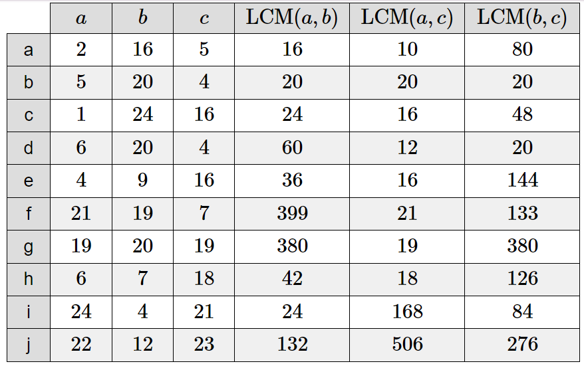
3. Complete the following table:
4. Answer the following questions:
a) Cara is buying nuts and bolts at a store. The store sells nuts in packs of 5 and bolts in packs of 10. If Cara wishes to buy the same number of nuts and bolts, what is the smallest number of nuts that she can buy?
b) A white light flashes every 28 seconds. A red light flashes every 7 seconds. They both flash at the same time. After how many seconds will they next both flash at the same time?
c) Buses to London leaves Norwich station every 30 minutes. Buses heading to Manchester leaves Norwich station every 20 minutes. At 10am a bus to London and a bus to Manchester both leave at the same time. Work out the next time that both buses leave at the same time.
10
28 seconds
11am

Slide 5
d) A bus leaves Antrim Bus Station every 12 minutes. A train leaves Antrim Train Station every 18 minutes. At 8m a bus and a train leave the stations at the same time.
i) When is the next time that a bus and a train leave at the same time?
ii) Between 8am and 11am (inclusive), on how many occasions does a bus and a train leave at the same time?
8:36am
6 times
e) Penny and Kenny have the same number of football cards. Penny has sorted her cards into piles of 10. Kenny has sorted his cards into piles of 18. Penny has less than 100 cards. How many football cards do they have?
f) The lowest common multiple of two numbers is 60. Only one of the numbers is a multiple of 4. Write down two possible numbers.
g) Jennifer says that the lowest common multiple of two consecutive numbers is equal to the product of the two numbers. By trying four different pairs of consecutive numbers, explore her theory
90
e.g. 15 and 4
e.g.
2 and 3: LCM = 6
9 and 10: LCM = 90
7 and 8: LCM = 56
1 and 2: LCM = 2

Slide 6
h) Miss Paisley is organising games for the children in her class. She is going to put the children into teams. If she puts the children into teams of 4, there will be 2 children left out. If she puts the children into teams of 5, there will be 3 children left out. Work out the smallest possible number of children in Miss Paisley's class.
18
Identifying the lowest common multiple of more than two numbers
Example 4 - I do…
Example 5 – We do…
Example 6 – You do…
Steps | Find the LCM of 2, 3 and 5 | Find the LCM of 5, 3 and 4 | Find the LCM of 6, 4 and 9
1) List the first few multiples of each number. 2) Identify the multiples common to all lists, then circle the lowest common multiple. | Multiples of 2 2, 4, 6, 8, 10, 12, 14, 16, 18, 20, 22, 24, 26, 28, 30… Multiples of 3 3, 6, 9, 12, 15, 18, 21, 24, 27, 30, 33… Multiples of 5 5, 10, 15, 20, 25, 30, 35… 30 | 5, 10, 15, 20, 25, 30, 35, 40, 45, 50, 55, 60, 65… 3, 6, 9, 12, 15, 18, 21, 24, 27, 30, 33, 36, 39, 42, 45, 48, 51, 54, 57, 60, 63, 66… 4, 8, 12, 16, 20, 24, 28, 32, 36, 40, 44, 48, 52, 56, 60, 64… 60 | 6, 12, 18, 24, 30, 36, 42… 4, 8, 12, 16, 20, 24, 28, 32, 36, 40, 44… 9, 18, 27, 36, 45, 54… 36
Independent Practice
5. Find the lowest common multiple (LCM) of each of these sets of numbers.
a) 2, 4 and 5 | b) 2, 5 and 7 | c) 5, 6 and 9
20
70
90

Slide 7
d) 10, 12 and 15 | e) 12, 15 and 18 | f) 15, 20 and 25
g) 4, 18 and 27 | h) 27, 36 and 90 | i) 35, 63 and 140
j) 28, 56 and 77 | k) 2, 3, 4 and 5 | l) 1, 2, 3, 4, 5 and 6.
60
180
300
108
540
540
616
60
60
6. These sets of numbers have 24 as their LCM. True or False?
d) 3, 4 and 8 True | 4, 6 and 12 False | f) 8, 6 and 12 True

Slide 8

7. These sets of numbers have 42 as their LCM. True or False?
a) 2, 3 and 7 True | b) 3, 4 and 7 False | c) 2,6 and 7 True
8. How can you tell that the lowest common multiple of:
a) 2,5 and 7 must be even? | b) two odd numbers must be odd? | c) an odd number and an even number must be even?
Because one of the numbers is two, so the answer must be in the two times table and therefore even. | If two numbers are odd, their product is odd. Their product is always a multiple of the lowest common multiple, which means the lowest common multiple must also be odd. | Because the multiples of all even numbers are even (as even x even = even and even x odd = even).

Slide 9
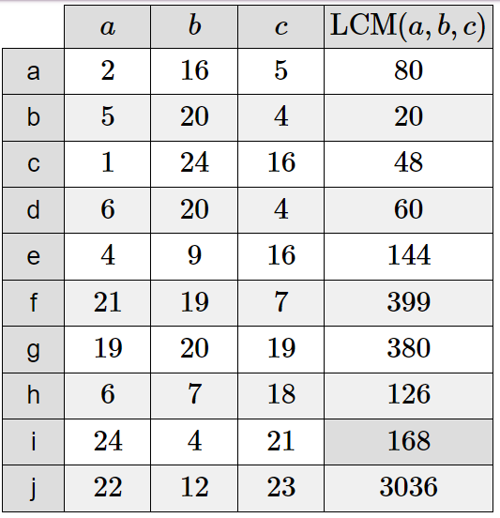
9. Complete the following table:

Slide 10
10. Answer the following questions:
a) A red light flashes every 3 seconds. A yellow light flashes every 8 seconds. A green light flashes every 11 seconds They all flash at the same time. After how many seconds will they next all flash at the same time?
264 seconds
b) Light A flashes every 5 seconds. Light B flashes every 6 seconds. Light C flashes every 7 seconds. All three lights flash at the same time. Work out how long it will take for all three lights to flash at the same time again.
210 seconds
c) Robert, John and Paul start to run from the same point, in the same direction, around a circular track. If they take 126 seconds, 154 seconds and 198 seconds respectively to complete one round along the track, when will they next meet again at the starting point?
After 1386 seconds
d) Three boys regularly visit the city centre in the morning. Paul goes every thirteen days, Peter goes every four days and Philip goes every two days. If they all visit the city on 1st January 2023, how many more times in 2023 will they all be in the city centre on the same morning?
7 times

Slide 11
11. Always, sometimes or never true? Give examples to support your answers.
a) The lowest common multiple of two numbers is the product of those two numbers.
Sometimes true. E.g. in the case of 3 and 2 (LCM 6) but not 6 and 12 (LCM 12)
b) The lowest common multiple of three numbers is the product of those three numbers.
Sometimes true. E.g. in the case of 1, 4 and 7 (LCM 28) but not 2, 4 and 7 (LCM 28)
c) The lowest common multiple of two numbers is greater than both of the numbers.
Sometimes true. E.g. in the case of 3 and 4 (LCM 12), but not 6 and 12 (LCM 12)
d) The lowest common multiple of three integer values will be an integer.
Always true. When listing multiple of an integer, there will never be a non-integer value.
e) The lowest common multiple of two integers is smaller than both of the integers.
Never true. When listing multiples of integers, the number increases as the multiplier increases, so the LCM cannot be smaller than the starting integer.

Slide 12

Skills Check
Calculate the lowest common multiple of 8 and 12 24 B. 4 C. 36 D. 48
A red light flashes every 10 seconds. A green light flashes every 15 seconds. They both just flashed. How long before they flash together again? 5 seconds B. 15 seconds C. 30 seconds D. 150 seconds
What is the lowest common multiple of 3, 4 and 10? 20 B. 30 C. 60 D. 120
Three bells are set to ring out at intervals of 4 minutes, 6 minutes and 9 minutes respectively. If they all ring together now, after how many minutes will they ring together next? 24 minutes B. 54 minutes C. 36 minutes D. 18 minutes

